Slide 1
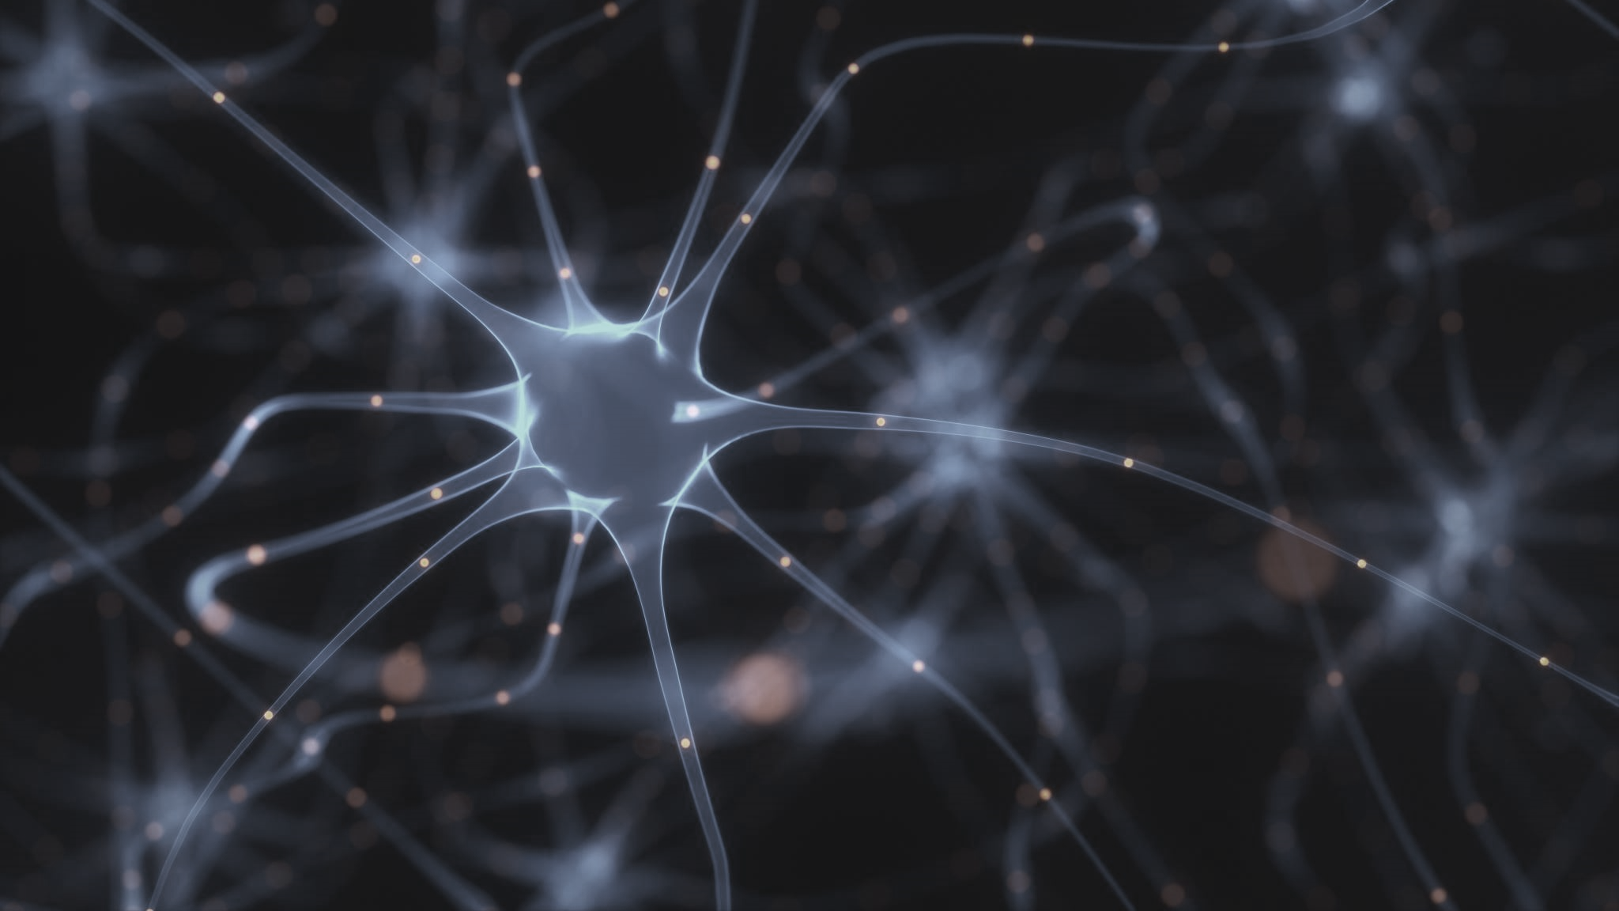
Multi – modal GLIOMA SEGMENTION AND CLASSIFICATION COUPLED WITH NLP ANALYSIS
JERMAINE SAMUELS

Slide 2

Introduction
Real time prediction of glioma type and Segment using Machine Learning on MRI scans.
Faster Time to provide Diagnosis
Less Invasive approach
Cost Effective
Process Automation
Image Type Agnostic
Capability to detect glioma from any plane

Slide 3
oBJECTIVE
To detect gliomas as segmented images and classify them as high-grade or low-grade glioma on 2D mri images and to investigate how segmentation may be improved by analysis of expert words referencing key features of gliomas.

Slide 4

Procedure
Image conversion from nii to png
Classification – via CNN
Segmentation – via unet CNN
Expert Analysis – via NLP
Test on Client Images

Slide 5
Tool description
Ability to upload multiple images
Image with greatest predicted segment will populate first
Cross reference expert segments with prediction for calibration
Ability to host tool on a server
Dashboard will be able to accommodate reports
Facilitate Reports

Slide 6

Classification AND SEGMENTATION on validation data
Metric | Classification | Segmentation
Accuracy | 60% | 98%
Dice Score | - | 40%
Specificity | - | 98%
Sensitivity | - | 45%

Slide 7

Test Images provided by uwi
Metric | Segmentation | Classification
Accuracy | 95% | 75%
Limitations
Only high-grade Glioma Images were provided for testing
25 % of data was used to build models

Slide 8
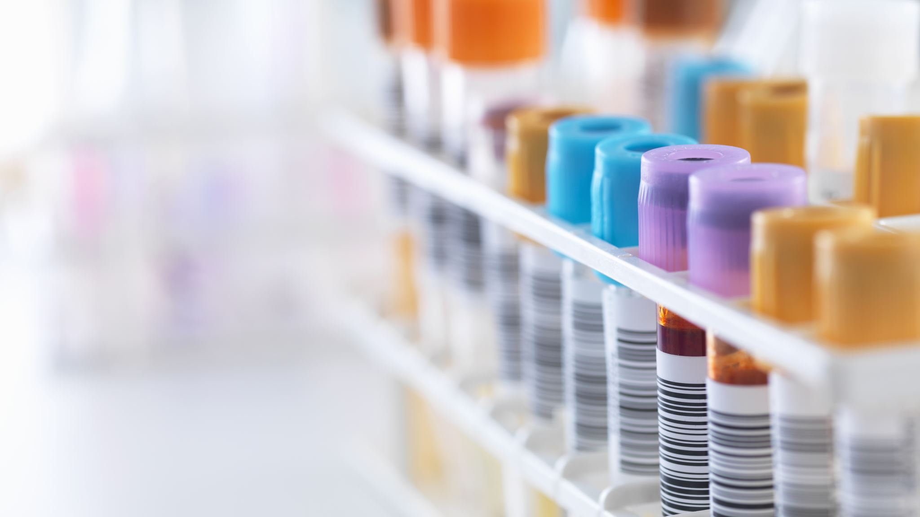
NLP ANALYSIS (corpus related to glioma over the past 10 years (2010 – 2020)
Key word Extraction excluding Necrotic Core, Edema and Enhancing Tumor
Endothelial
Glioma Stem
Vessel
Endothelial cells
Stem
Glioma Stem cell
Blood vessel
Stem cell
Vascular
blood
* Possible feature to add to segmentation is aberrant blood vessel formation

Slide 9
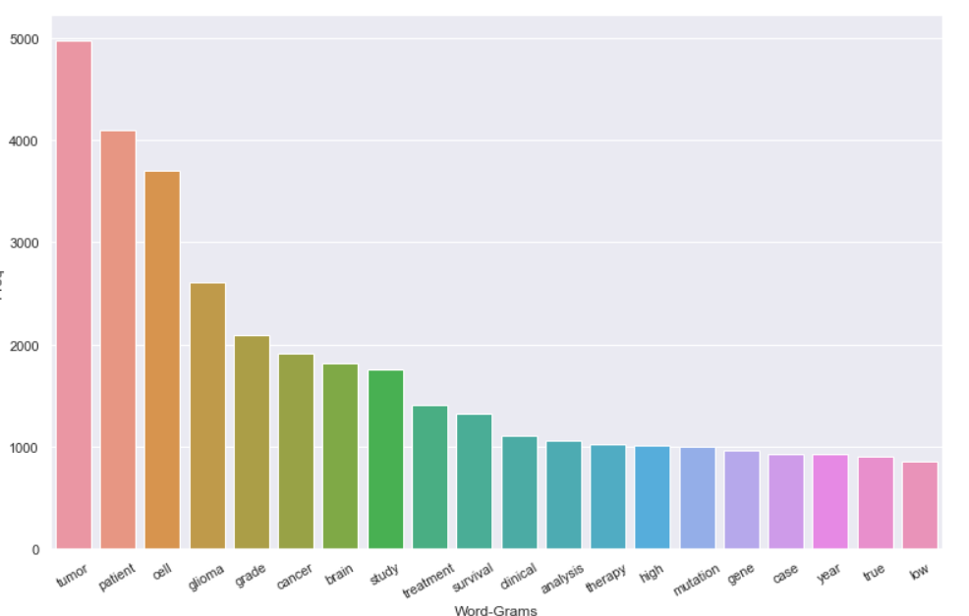
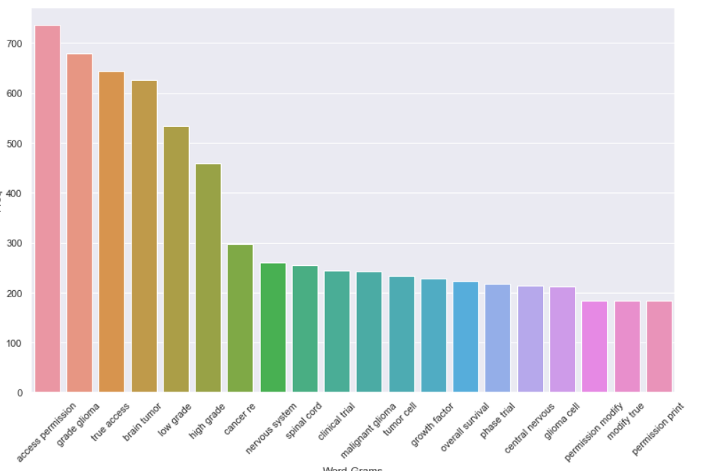
UNIGRAM and Bigram - Nlp Analysis Continued
Unigram
Bigram

Slide 10
NLP Analysis continued
The Tool will display Unigram, Bigram frequency and frequency of experts referencing the word necrotic core, edema and enhancing tumor over the pass 10 years (2010 – 2020) as a reporting feature of the dashboard

Slide 11
Tool deliverables
Dashboard for segmenting and classifying images
Ability to download classification results as a csv file
Report on NLP Analysis (Expert words within the last 10 year)

Slide 12

Limitations
Only high-grade Glioma Images were provided for testing from the UWI
25 % of data was used to build models
Transfer Learning may yield better results
Models are independent of each other and so domain logic required for populating data on the dashboard

Slide 13
References

